Slide 1
Sentinel2 ALR Results
Kate Harvey
(Last Updated November 2021)

Slide 2
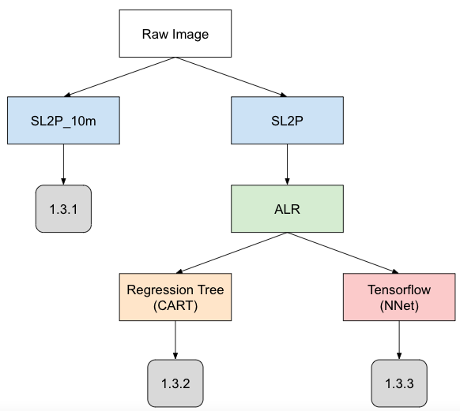
Image processing workflow

Slide 3
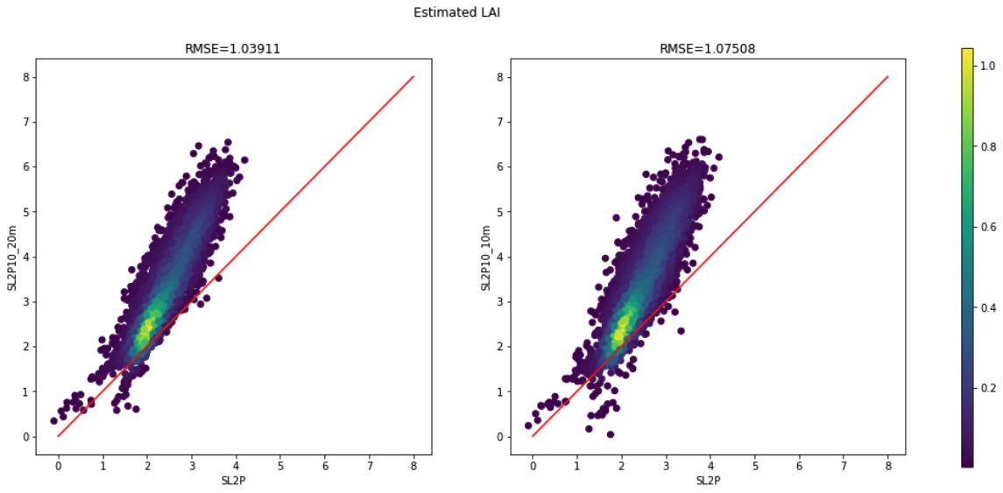
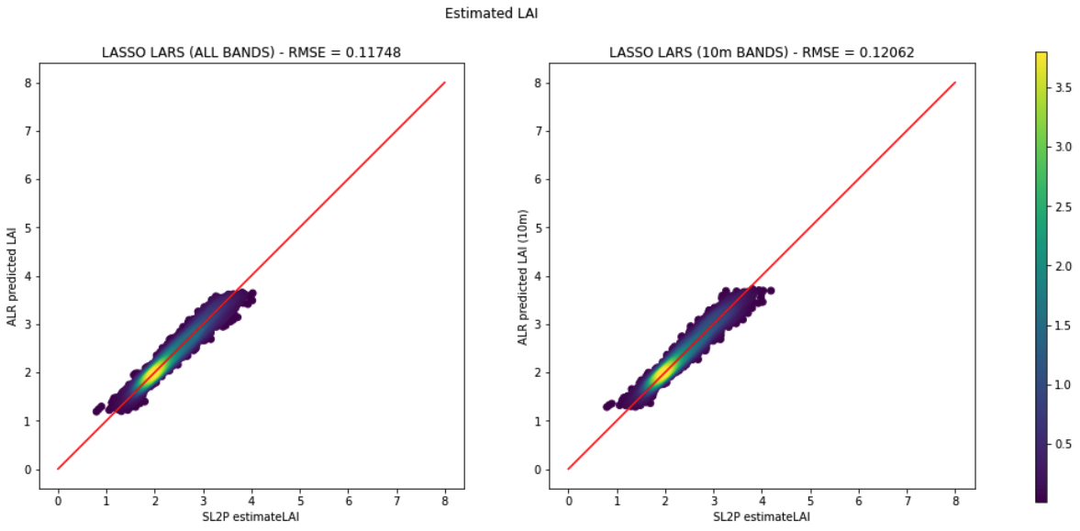
SL2P10 Outputs
ALR + NNET Outputs
Geraldton, ON

Slide 4
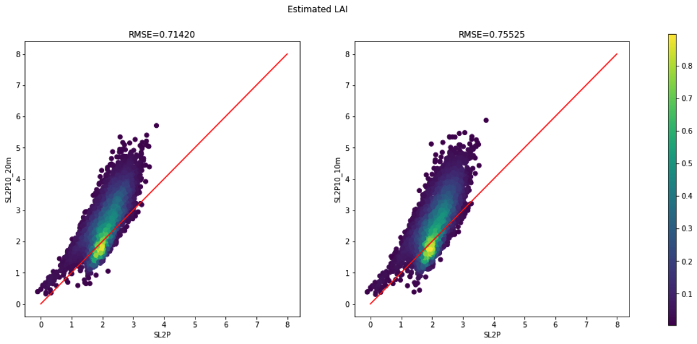
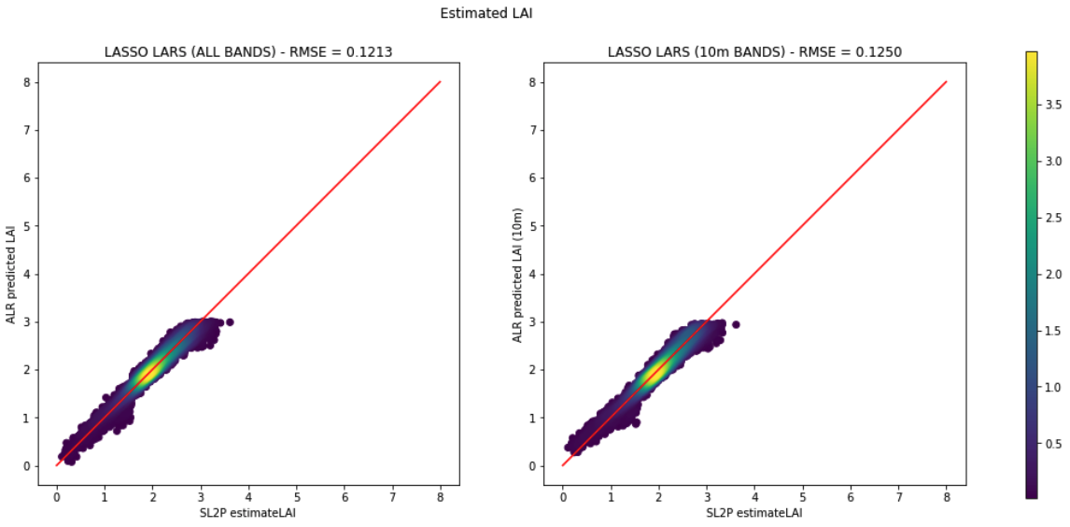
SL2P Outputs
ALR Outputs
Fox Creek, AB

Slide 5
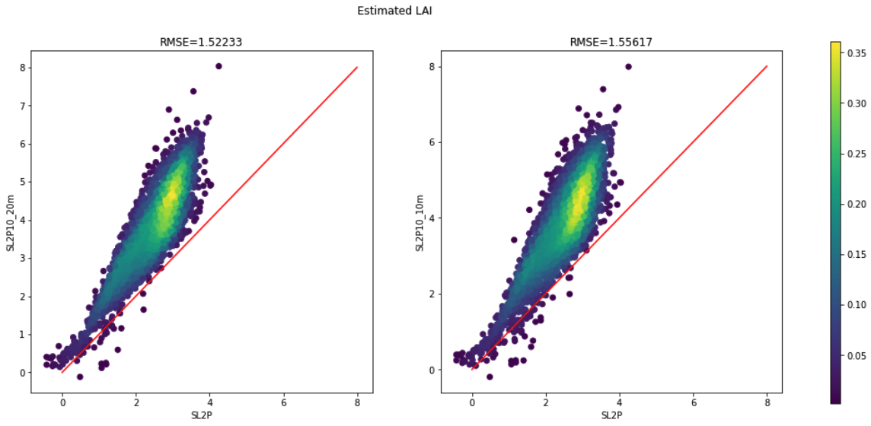
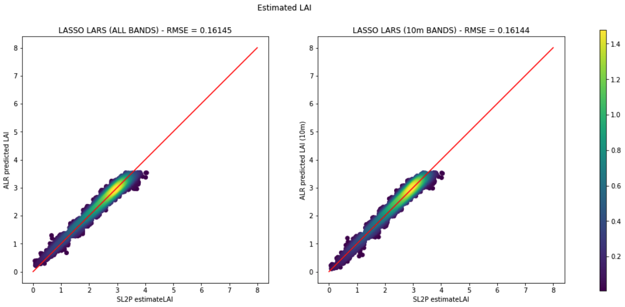
SL2P Outputs
ALR Outputs
Kouchibouguac, NB

Slide 6
Regression Trees
Random Forest vs. CART

Slide 7
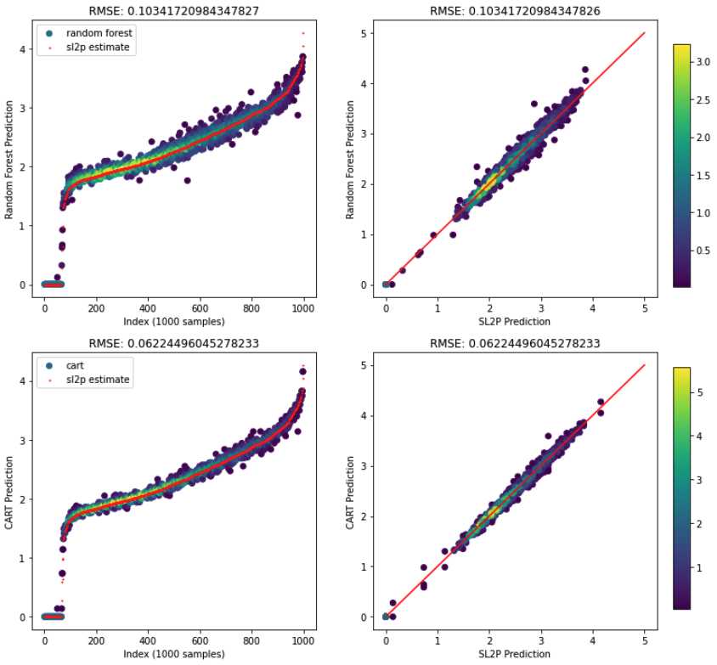
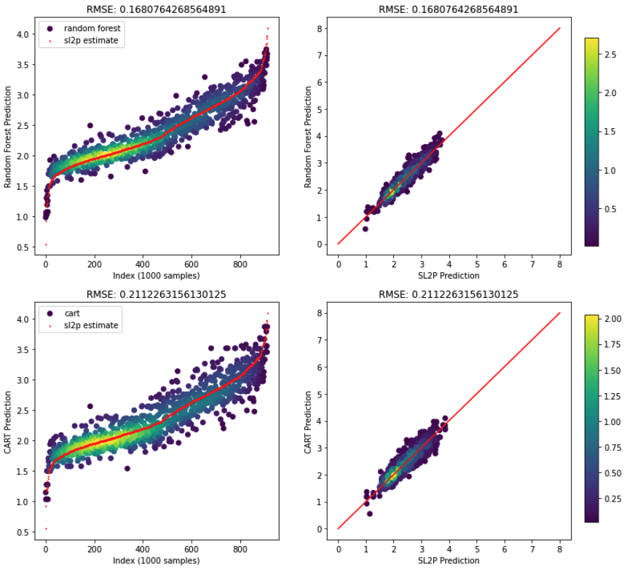
Hold-out cross-validation
Geraldton – LAI

Slide 8
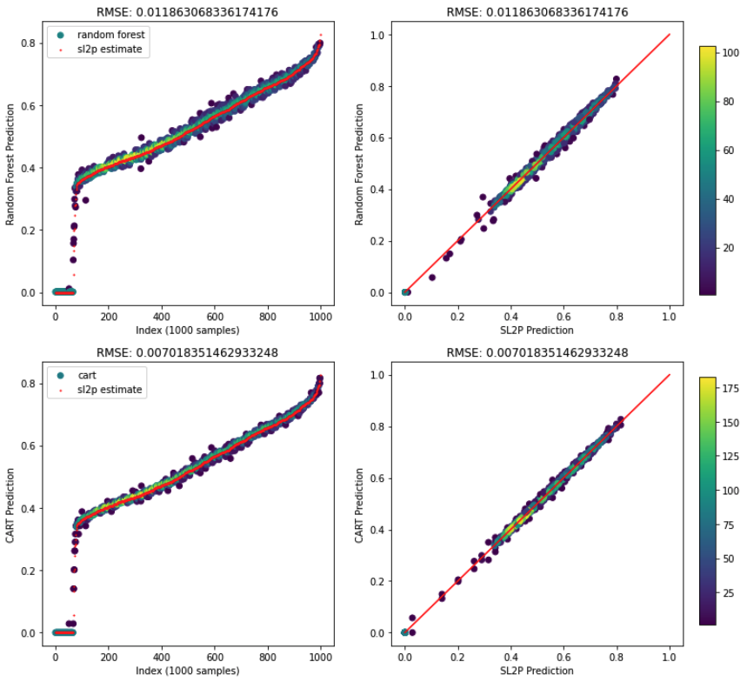
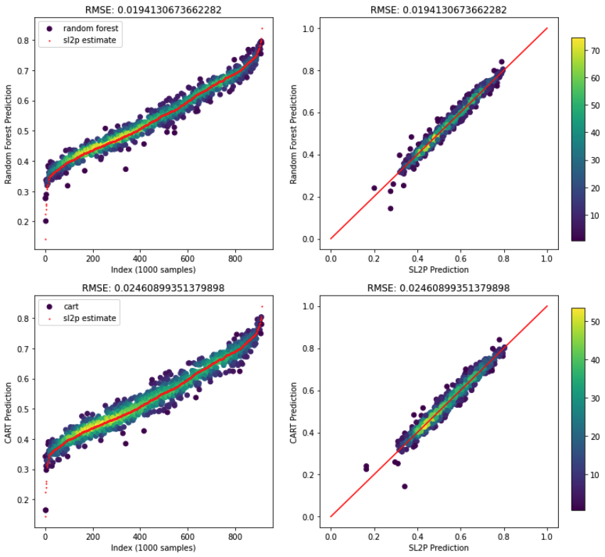
Hold-out cross-validation
Geraldton – fCOVER

Slide 9
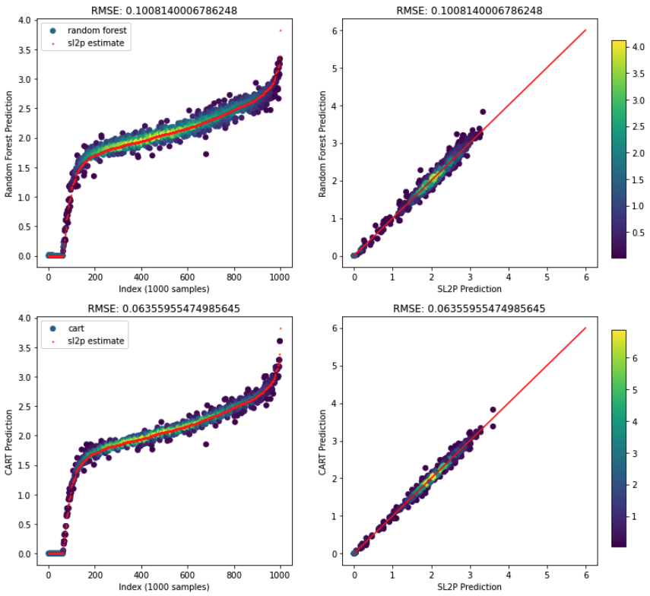
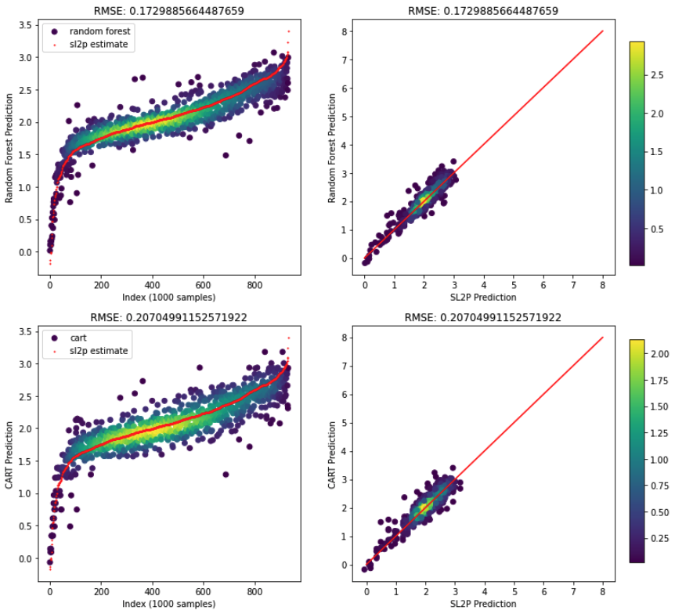
Hold-out cross-validation
Fox Creek – LAI

Slide 10
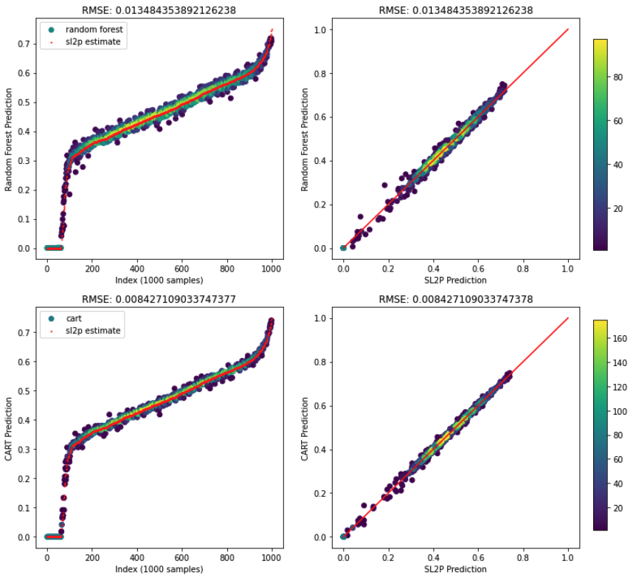
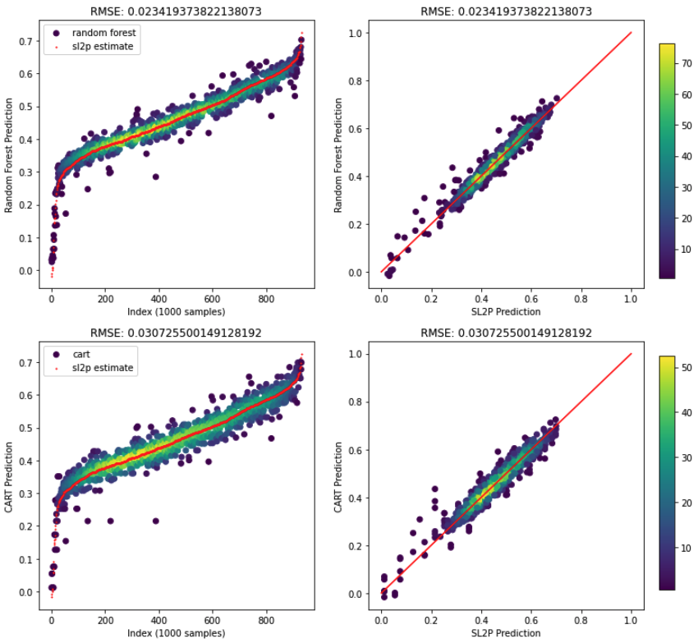
Hold-out cross-validation
Fox Creek – fCOVER

Slide 11
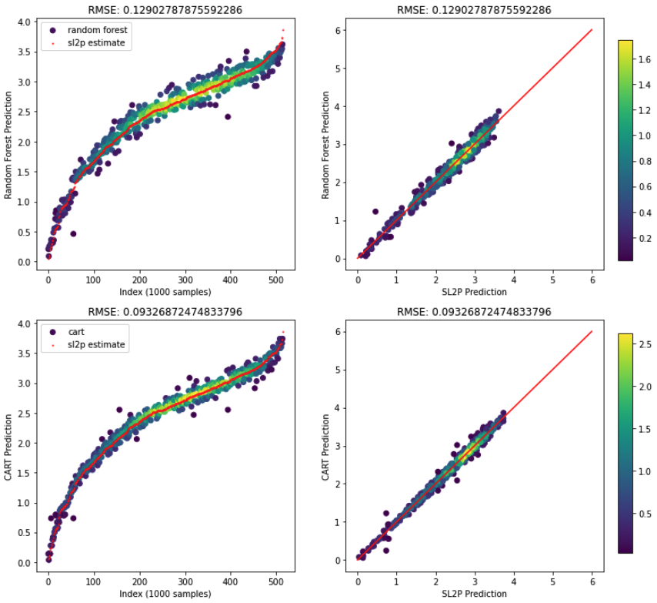
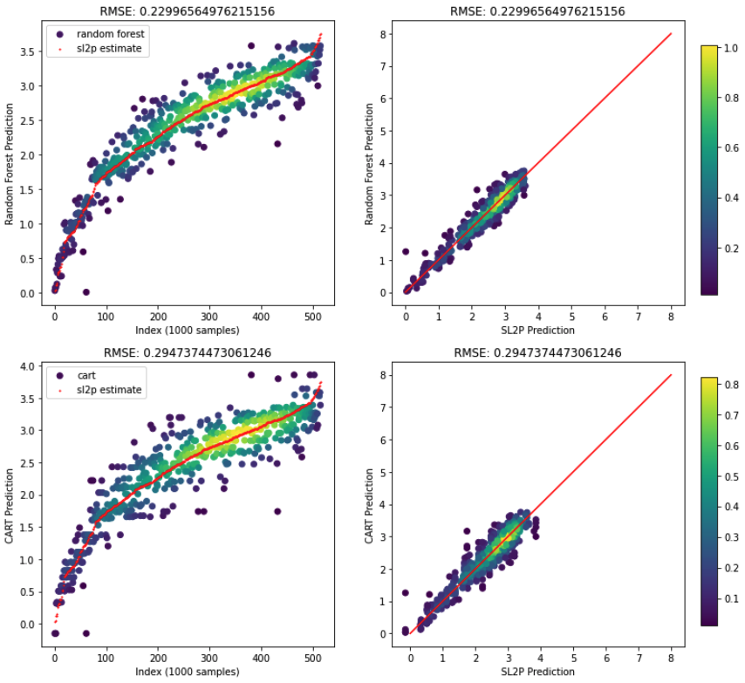
Hold-out cross-validation
Kouchibouguac – LAI

Slide 12
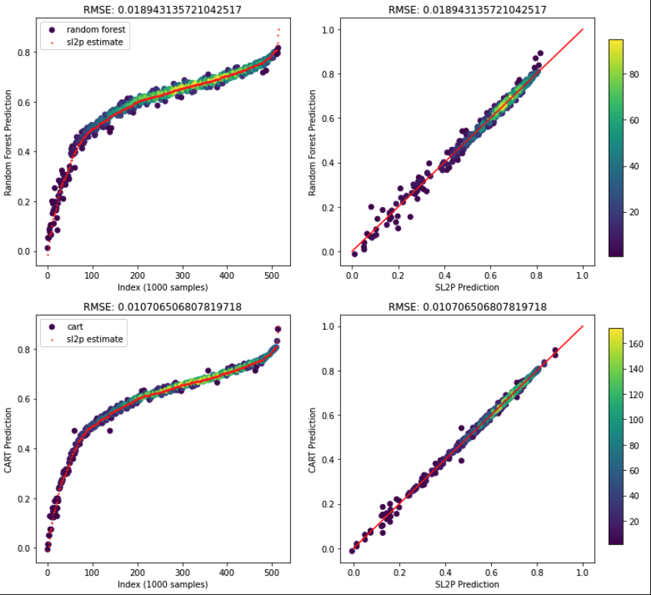
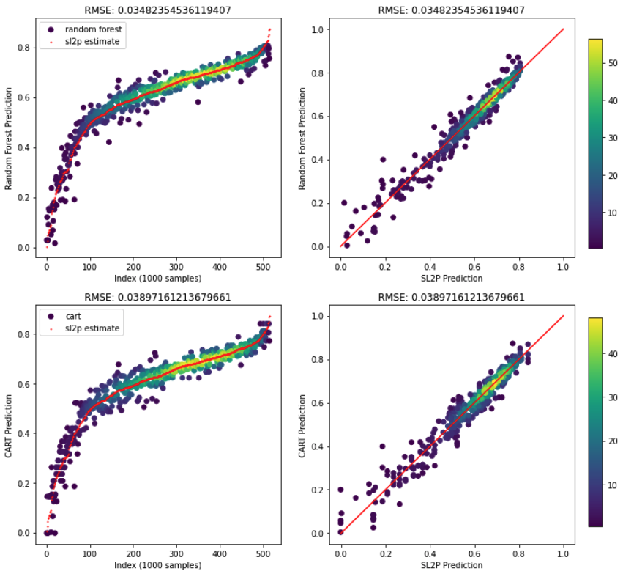
Hold-out cross-validation
Kouchibouguac – fCOVER

Slide 13
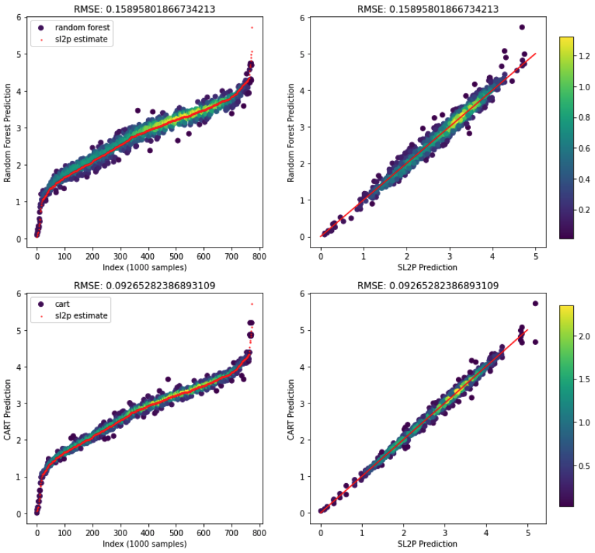
Random Forest
CART
Ottawa – LAI

Slide 14
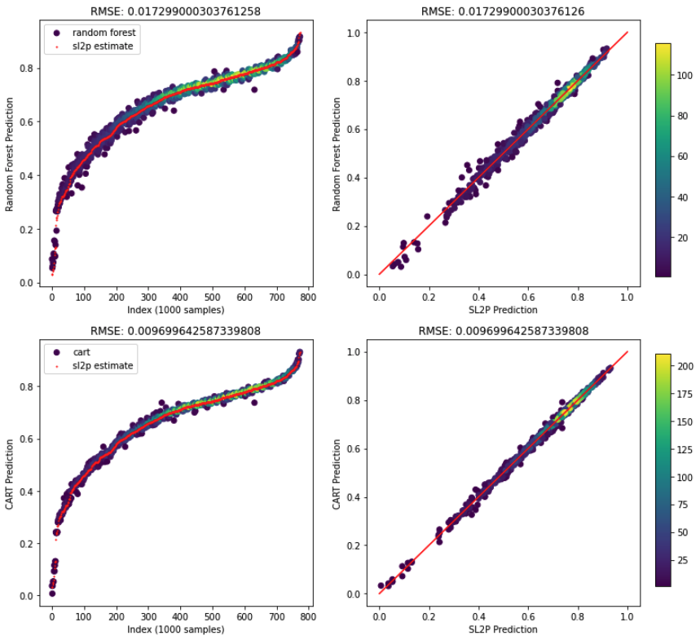
Random Forest
CART
Ottawa – fCOVER

Slide 15
Additional Test Sites
ALR and Regression Tree outputs

Slide 16
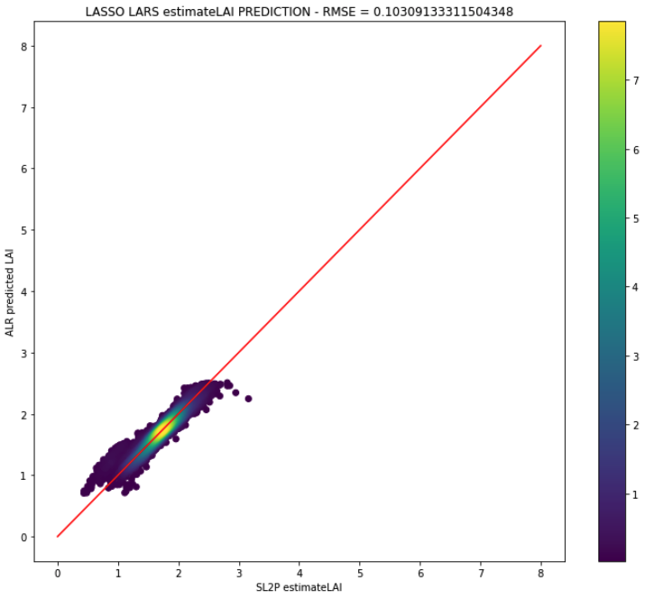
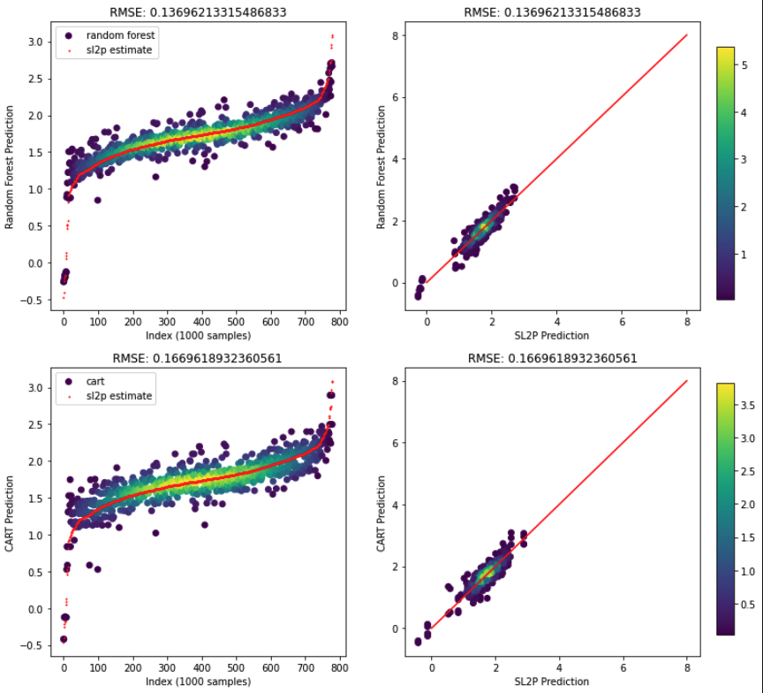
Hold-out cross-validation
Wabush – LAI

Slide 17
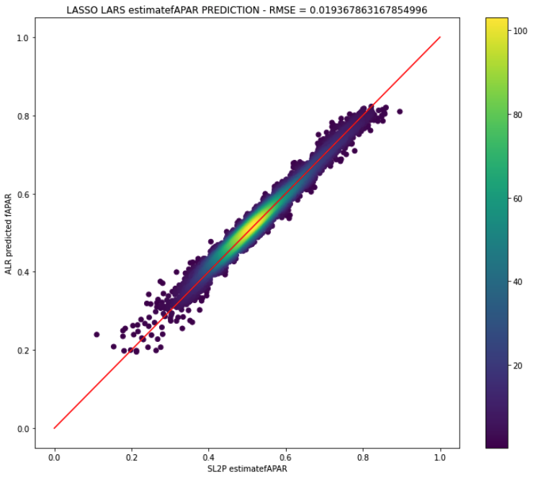
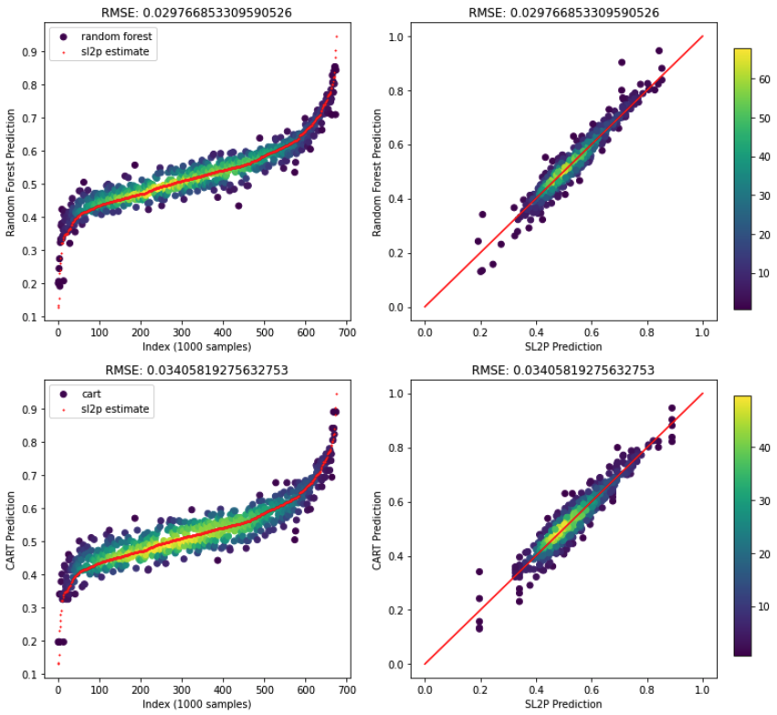
Queen Charlotte – fAPAR

